Slide 1



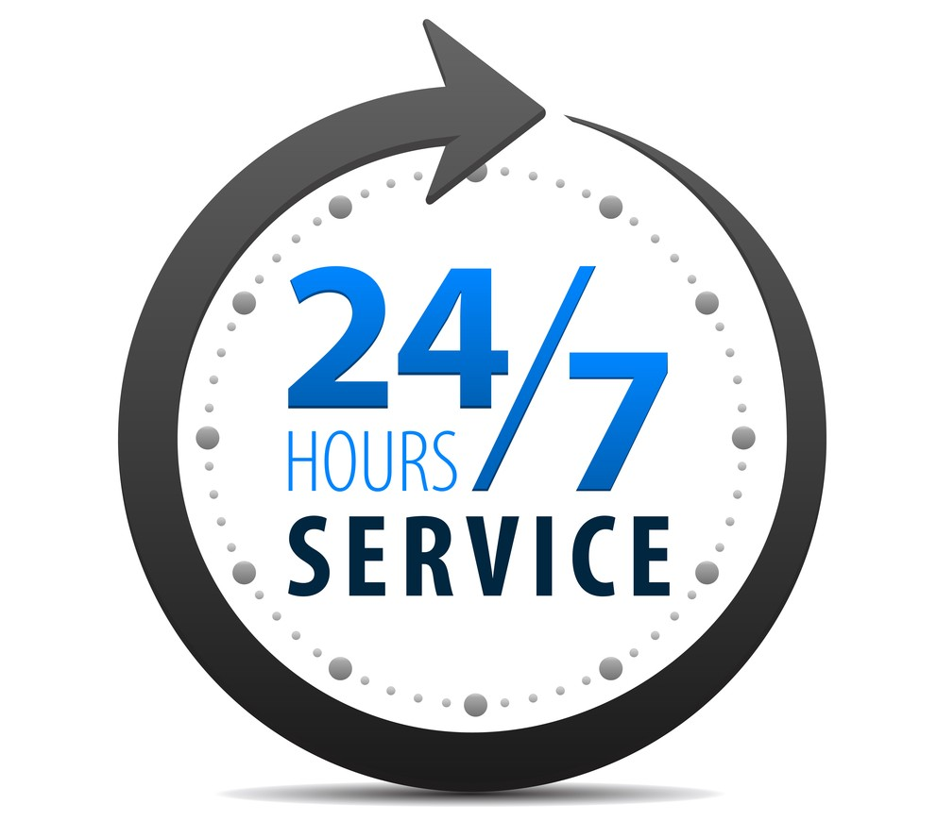



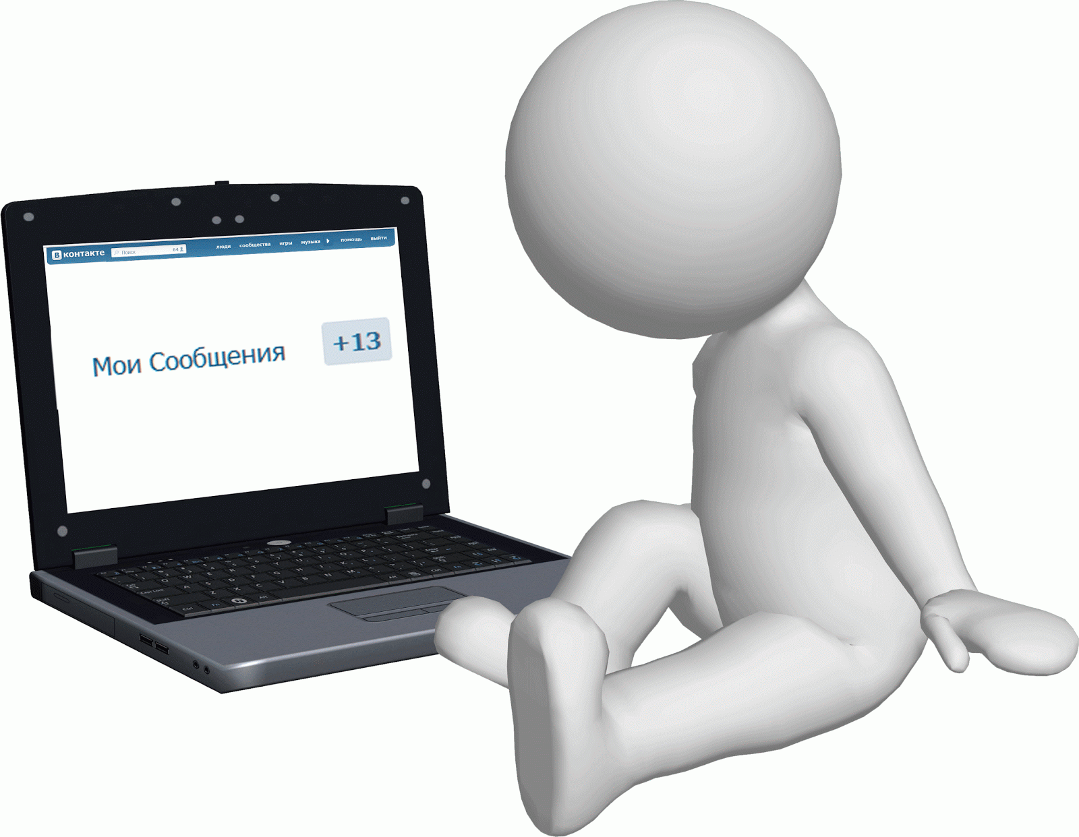



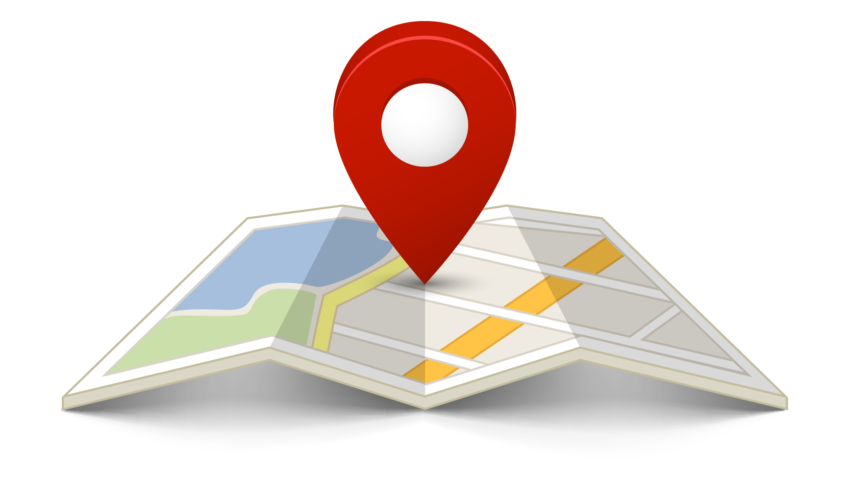

User requirements
Using the system without the need for additional training
Reliability, correct and obvious behavior of the system operation
Discussion with other users
Reliability, correct and obvious behavior of the system operation
The user should be able to access the system at any time - 24/7/365
Search for interesting places by keywords
Ability to customize the personal interface
Ability to use the system on any device
Receive notifications about new events in the city where the user resides
Automatic system restore in case of failure
Optimization of Internet traffic consumption by the system
Ban on anonymous responses
The ability to track the location of the user to determine the nearest objects of interest
User data security

